Slide 1

Stock Market Data Analysis
TEAM
Shubham Chumber (A00433094)
Sachit Jain (A00432721)
Gyaneshwar Rao Nampally (A00433014 )
Vamsi Manda (A00433234)
Kshitij Parashar (A00430628)

Slide 2
Project Resource
The aim of the project is to take large chunks of aggregated Big data collected over multiple years, process these datasets to extract market knowledge and thereby leverage these insights gained to make predictions and analyze trends. The Big data application works with companies financial stock data as warehoused by the S&P 500 indexing to understand the future trends in the pricing of the stocks for various companies subject to various external constraints.

Slide 3
About the Data
• Date - in format: yy-mm-dd
• Open - price of the stock at market open (this is NYSE data so all in USD)
• High - Highest price reached in the day
• Low Close - Lowest price reached in the day
• Volume - Number of shares traded
• Name - the stock's ticker name

Slide 4








Technologies Used

Slide 5
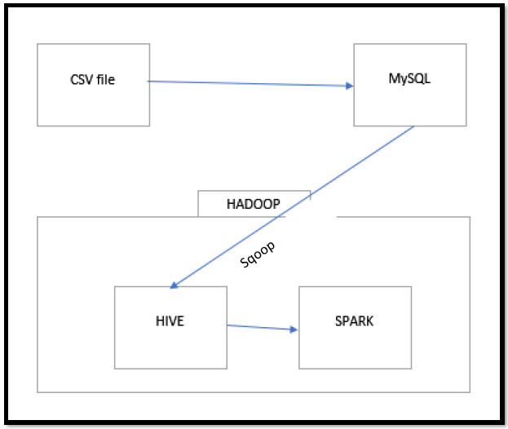
Architecture
Notes:
SQOOP - a tool to interact with the relational database servers for importing and exporting the Big Data residing in them. It is provided by the Apache Software Foundation and allows two data transference.
HDFS -

Slide 6
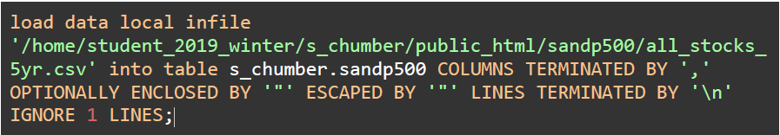
CSV to mySQL

Slide 7
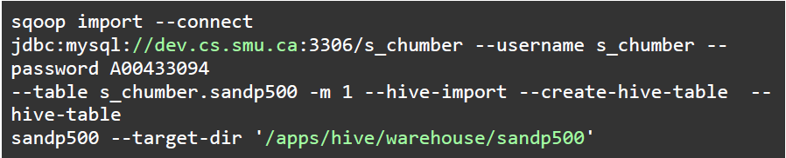
SQL to HADOOP using SQOOP

Slide 8
Data Analysis

Slide 9
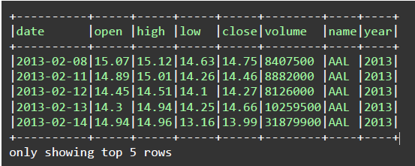
Stock Data in spark

Slide 10
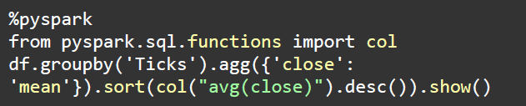
Calculating average closing price

Slide 11
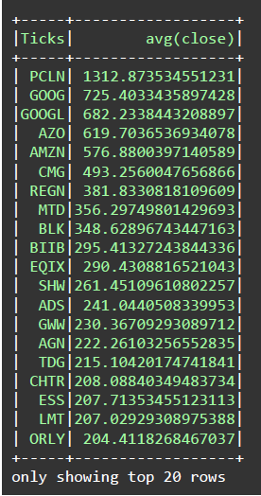
Average Closing Price.

Slide 12
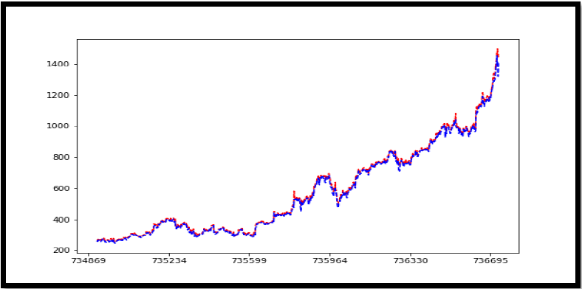
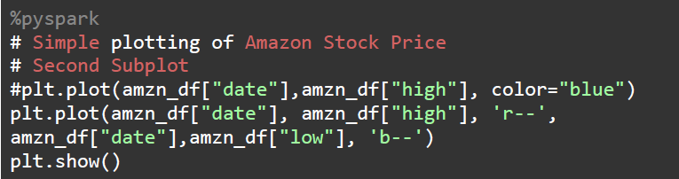
Amazon Stock

Slide 13
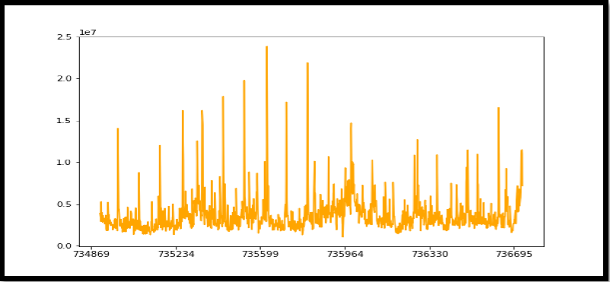
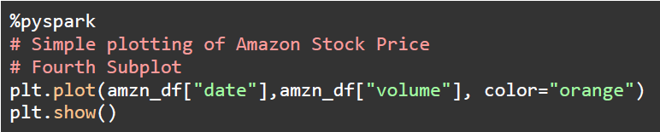
Traded Volume

Slide 14
Linear Regression

Slide 15
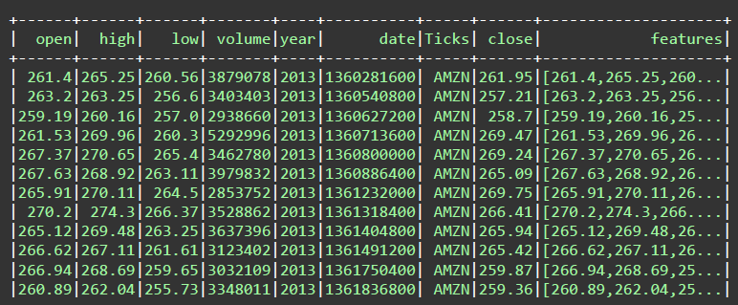
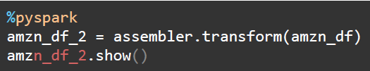
Creating Features to Train

Slide 16
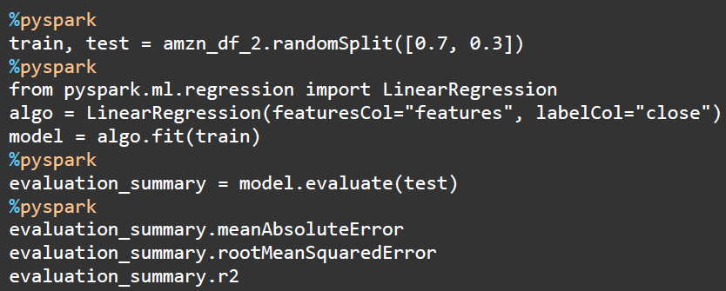

Linear Regression
MAE:
RMSE:
R2:

Slide 17
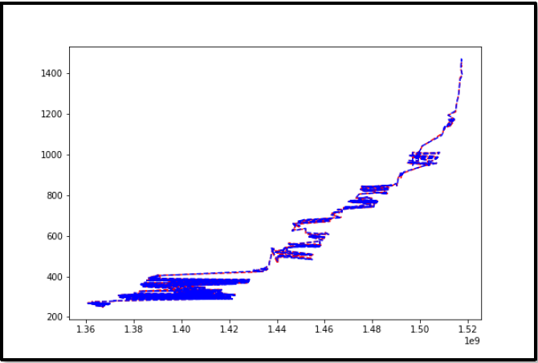
Plot between Actual and prediction

Slide 18
CLUSTERING

Slide 19
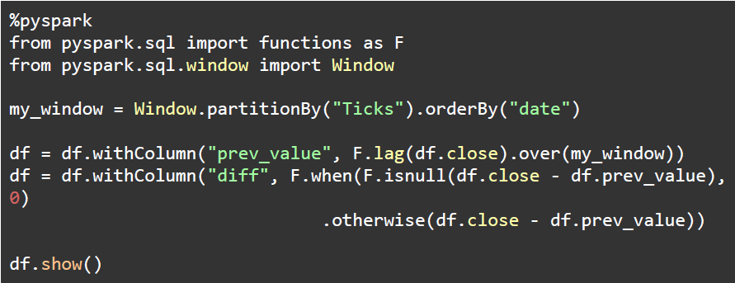
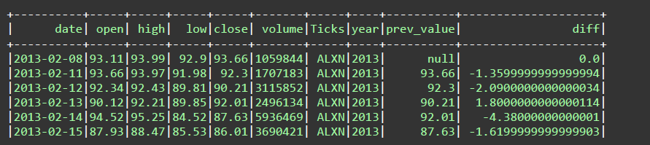
Data Preparation

Slide 20
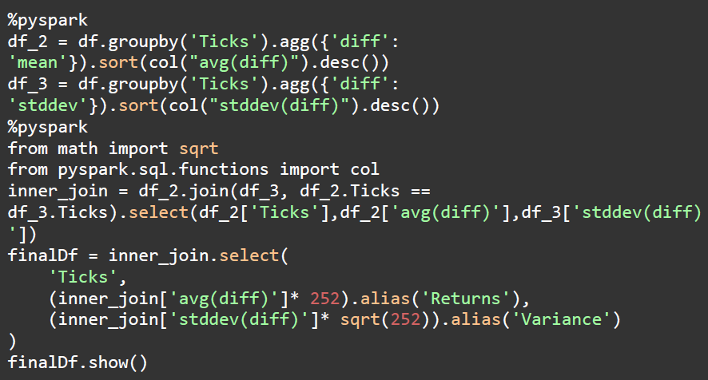
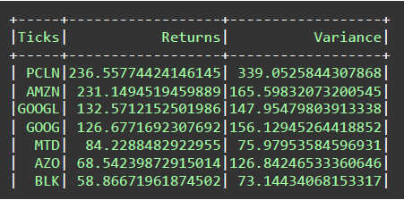
Feature Extraction

Slide 21
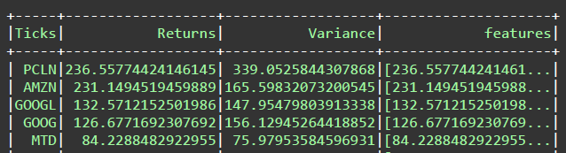
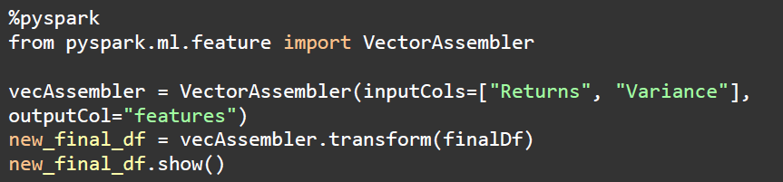
Features

Slide 22
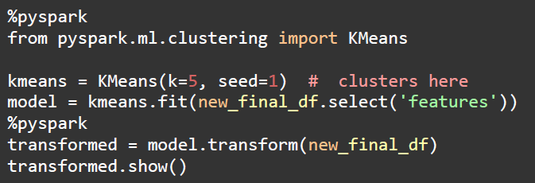
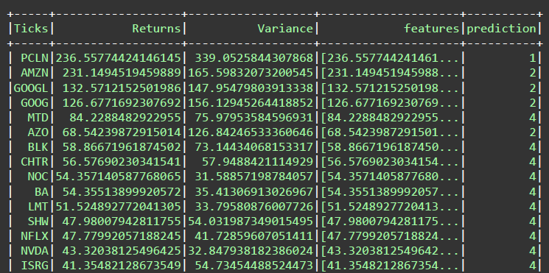
K-means

Slide 23
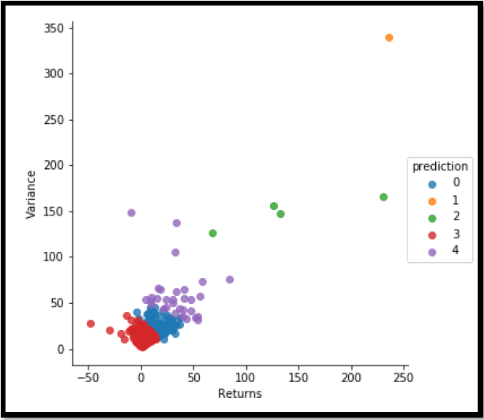
Clusters

Slide 24
THANK YOU

